Slide 1
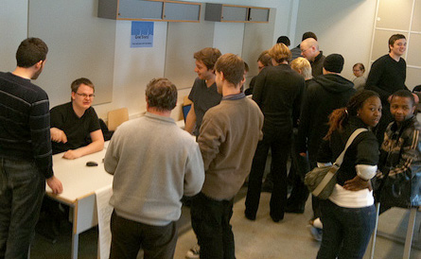
XX00BH18-3488
Innovation Project 12.1.2023
Hannu Markkanen Amir Dirin

Slide 2
Today's schedule
13.30 | Selecting projects and forming teams
14:00 | Getting familiar with the Design sprint day 1
14.30 - | Do the items 1-3 on its checklist of Design sprint day 1 Do the assignment in Oma: Teaming up & preparing for kick-off
Make sure all the newly created documents are shared with your team
Also share the documents with the teachers
hannu.markkanen@metropolia.fi
amir.dirin@metropolia.fi

Slide 3
Spring 2023 projects
1. Nokia: Application of IoT security (Case Study)
Project descriptions are located in this Oma folder: Documents - Project descriptions

Slide 4
Process for assigning the tentative teams
Tentatively assign yourself to the project that interests you the most. https://docs.google.com/spreadsheets/d/1ZNZvQoL-EIisL7Z273i63EffdEvZ70GH_xEm-JPfIj8/edit?usp=sharing
Review of the teams
Breakout room created for each team
In the tentative teams: introductions, discussion of the topic, roles. (30 minutes).
Final teams will be decided.

Slide 5
Next week
Kickoff with partners
Finalize design sprint day 1

